Slide 1
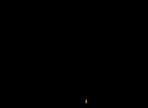
Welcome to the World of
Chemistry
Honors: Ch. 1 and 5
Regular: Ch. 1 and 3
ICP: Ch. 1
SAVE PAPER AND INK!!! When you print out the notes on PowerPoint, print "Handouts" instead of "Slides" in the print setup. Also, turn off the backgrounds (Tools>Options>Print>UNcheck "Background Printing")!

Slide 2
The Language of Chemistry
CHEMICAL _____________ -
  pure substances that cannot be decomposed by ordinary means to other substances.
Aluminum
Bromine
Sodium

Slide 3
The Language of Chemistry
The elements, their names, and symbols are given on the PERIODIC TABLE
How many elements are there?
  117 elements have been identified
  82 elements occur naturally on Earth
      Examples: gold, aluminum, lead, oxygen, carbon
    35 elements have been created by scientists
      Examples: technetium, americium, seaborgium

Slide 4
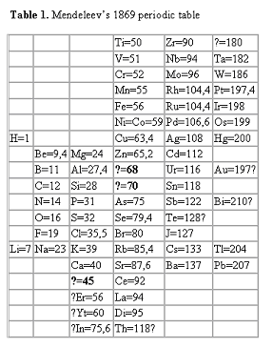
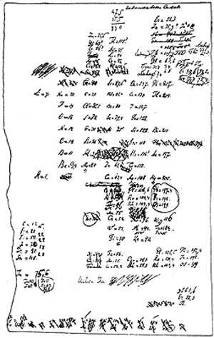
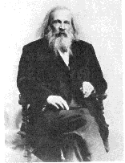
The Periodic Table
Dmitri Mendeleev (1834 - 1907)

Slide 5
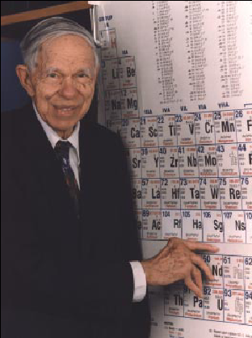
Glenn Seaborg
(1912-1999)
Discovered 8 new elements.
Only living person for whom an element was named.

Slide 6
Branches of Chemistry
Many major areas of study for specialization
Several career opportunities
Also used in many other jobs

Slide 7
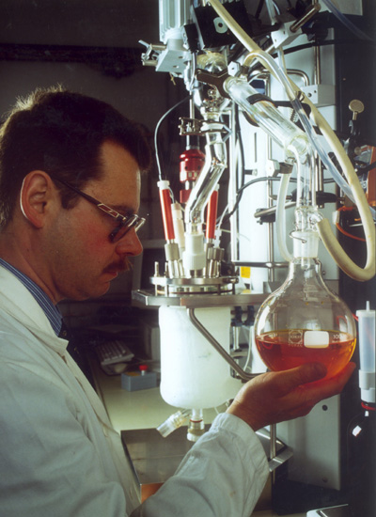
1. Organic Chemistry
Organic is the study of matter that contains carbon
Organic chemists study the structure, function, synthesis, and identity of carbon compounds
Useful in petroleum industry, pharmaceuticals, polymers

Slide 8
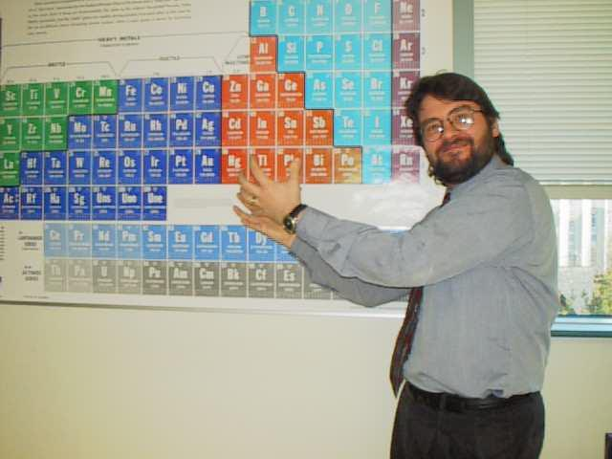
2. Inorganic Chemistry
Inorganic is the study of matter that does NOT contain carbon
Inorganic chemists study the structure, function, synthesis, and identity of non-carbon compounds
Polymers, Metallurgy

Slide 9
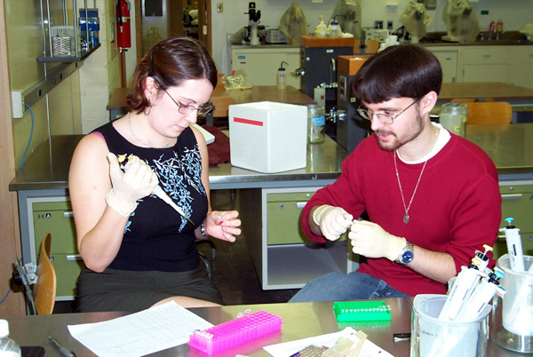
3. Biochemistry
Biochemistry is the study of chemistry in living things
Cross between biology and chemistry
Pharmaceuticals and genetics

Slide 10
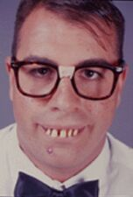
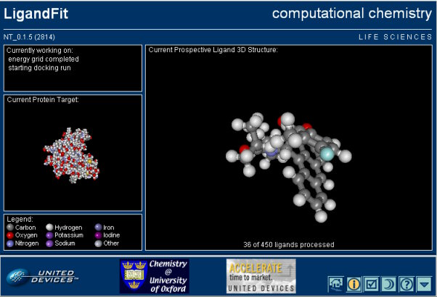
4. Physical Chemistry
HONK if you passed p-chem
Physical chemistry is the physics of chemistry… the forces of matter
Much of p-chem is computational
Develop theoretical ideas for new compounds

Slide 11
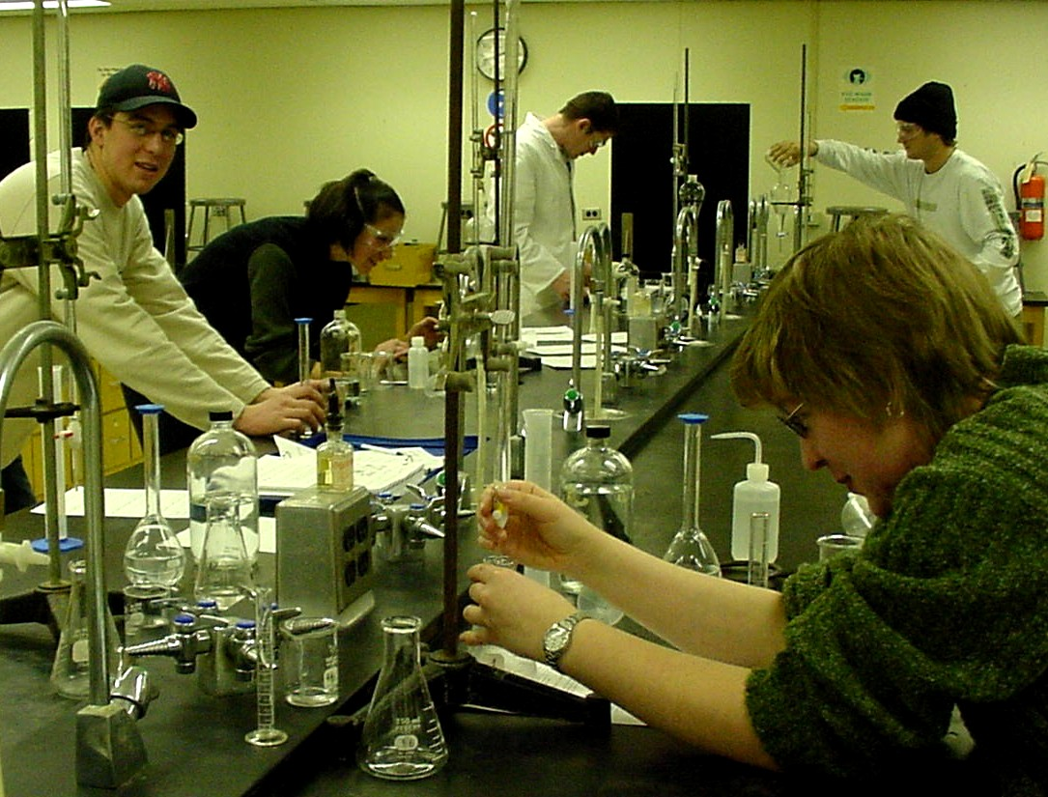
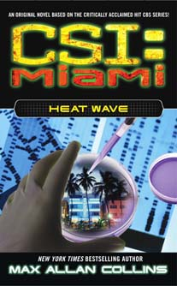
5. Analytical Chemistry
Analytical chemistry is the study of high precision measurement
Find composition and identity of chemicals
Forensics, quality control, medical tests

Slide 12
Types of Observations and Measurements
We make QUALITATIVE observations of reactions — changes in color and physical state.
We also make QUANTITATIVE MEASUREMENTS, which involve numbers.
  Use SI units — based on the metric system

Slide 13
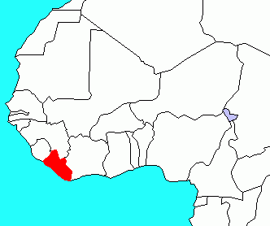
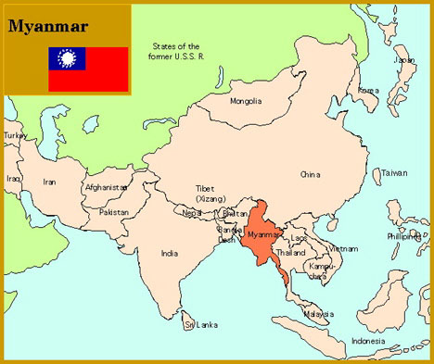
SI measurement
Le Système international d'unités
The only countries that have not officially adopted SI are Liberia (in western Africa) and Myanmar (a.k.a. Burma, in SE Asia), but now these are reportedly using metric regularly
Metrication is a process that does not happen all at once, but is rather a process that happens over time.
Among countries with non-metric usage, the U.S. is the only country significantly holding out. The U.S. officially adopted SI in 1866.
Information from U.S. Metric Association

Slide 14
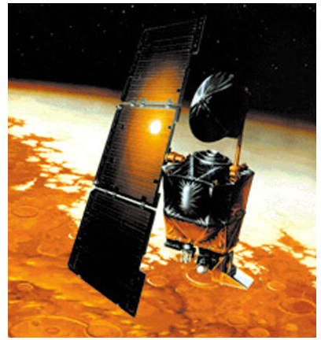
Chemistry In Action
On 9/23/99, $125,000,000 Mars Climate Orbiter entered Mars’ atmosphere 100 km lower than planned and was destroyed by heat.
1 lb = 1 N
1 lb = 4.45 N
“This is going to be the cautionary tale that will be embedded into introduction to the metric system in elementary school, high school, and college science courses till the end of time.”

Slide 15
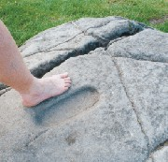
Standards of Measurement
When we measure, we use a measuring tool to compare some dimension of an object to a standard.
For example, at one time the standard for length was the king’s foot. What are some problems with this standard?

Slide 16
What is Scientific Notation?
Scientific notation is a way of expressing really big numbers or really small numbers.
For very large and very small numbers, scientific notation is more concise.

Slide 17
Scientific notation consists of two parts:
A number between 1 and 10
A power of 10
N x 10^{x}

Slide 18
To change standard form to scientific notation…
Place the decimal point so that there is one non-zero digit to the left of the decimal point.
Count the number of decimal places the decimal point has “moved” from the original number. This will be the exponent on the 10.
If the original number was less than 1, then the exponent is negative. If the original number was greater than 1, then the exponent is positive.

Slide 19
Examples
Given: 289,800,000
Use: 2.898 (moved 8 places)
Answer: 2.898 x 10⁸
Given: 0.000567
Use: 5.67 (moved 4 places)
Answer: 5.67 x 10⁻⁴

Slide 20
To change scientific notation to standard form…
Simply move the decimal point to the right for positive exponent 10.
Move the decimal point to the left for negative exponent 10.
(Use zeros to fill in places.)

Slide 21
Example
Given: 5.093 x 10⁶
Answer: 5,093,000 (moved 6 places to the right)
Given: 1.976 x 10⁻⁴
Answer: 0.0001976 (moved 4 places to the left)

Slide 22
Learning Check
Express these numbers in Scientific Notation:
405789
0.003872
3000000000
2
0.478260

Slide 23
Stating a Measurement
In every measurement there is a
Number followed by a
Unit from a measuring device
The number should also be as precise as the measurement!

Slide 24
UNITS OF MEASUREMENT
Use SI units — based on the metric system
Length
Mass
Volume
Time
Temperature
Meter, m
Kilogram, kg
Liter, L
Seconds, s
Celsius degrees, ˚C
kelvins, K

Slide 25
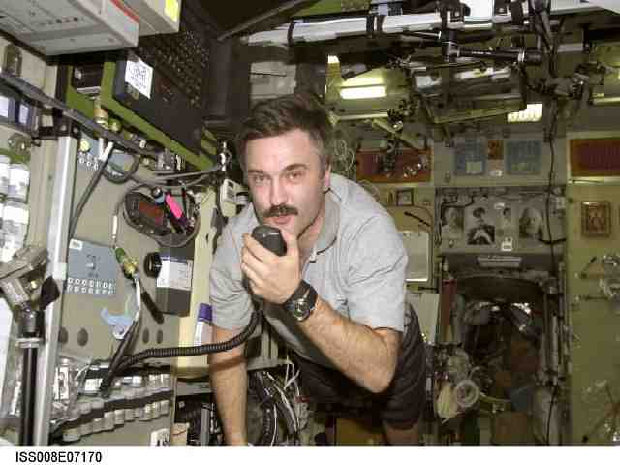
Mass vs. Weight
Mass: Amount of Matter (grams, measured with a BALANCE)
Weight: Force exerted by the mass, only present with gravity (pounds, measured with a SCALE)
Can you hear me now?

Slide 26

Some Tools for Measurement
Which tool(s) would you use to measure:
A. temperature
B. volume
C. time
D. weight

Slide 27
Learning Check
Match L) length M) mass V) volume
____ A. A bag of tomatoes is 4.6 kg.
____ B. A person is 2.0 m tall.
____ C. A medication contains 0.50 g Aspirin.
____ D. A bottle contains 1.5 L of water.
M
L
M
V

Slide 28
Learning Check
What are some U.S. units that are used to measure each of the following?
A. length
B. volume
C. weight
D. temperature

Slide 29
Metric Prefixes
Kilo- means 1000 of that unit
  1 kilometer (km) = 1000 meters (m)
Centi- means 1/100 of that unit
  1 meter (m) = 100 centimeters (cm)
  1 dollar = 100 cents
Milli- means 1/1000 of that unit
  1 Liter (L) = 1000 milliliters (mL)

Slide 30
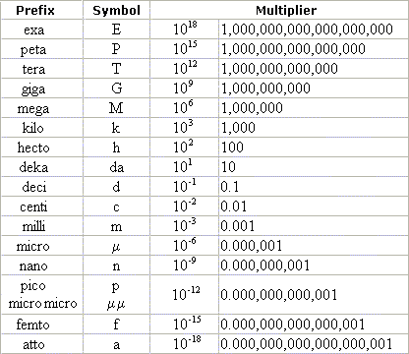
Metric Prefixes

Slide 31
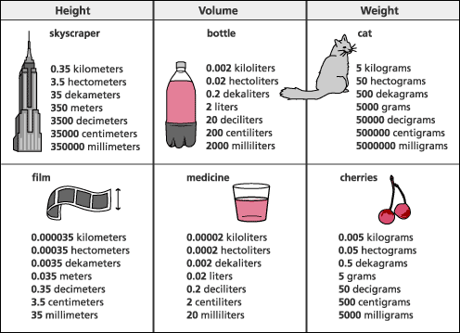
Metric Prefixes

Slide 32
Learning Check
1. 1000 m = 1 ___ a) mm b) km c) dm
2. 0.001 g = 1 ___ a) mg b) kg c) dg
3. 0.1 L = 1 ___ a) mL b) cL c) dL
4. 0.01 m = 1 ___ a) mm b) cm c) dm

Slide 33
Units of Length
? kilometer (km) = 500 meters (m)
2.5 meter (m) = ? centimeters (cm)
1 centimeter (cm) = ? millimeter (mm)
1 nanometer (nm) = 1.0 x 10⁻⁹ meter
O—H distance =
9.4 x 10⁻¹¹ m
9.4 x 10⁻⁹ cm
0.094 nm

Slide 34
Learning Check
Select the unit you would use to measure
1. Your height
a) millimeters b) meters c) kilometers
2. Your mass
a) milligrams b) grams c) kilograms
3. The distance between two cities
a) millimeters b) meters c) kilometers
4. The width of an artery
a) millimeters b) meters c) kilometers

Slide 35
Conversion Factors
Fractions in which the numerator and denominator are EQUAL quantities expressed in different units
Example: 1 in. = 2.54 cm
Factors: 1 in. and 2.54 cm
2.54 cm 1 in.

Slide 36
Learning Check
Write conversion factors that relate each of the following pairs of units:
1. Liters and mL
2. Hours and minutes
3. Meters and kilometers

Slide 37
How many minutes are in 2.5 hours?
Conversion factor
2.5 hr x 60 min = 150 min
1 hr
cancel
By using dimensional analysis / factor-label method, the UNITS ensure that you have the conversion right side up, and the UNITS are calculated as well as the numbers!

Slide 38
Steps to Problem Solving
Write down the given amount. Don’t forget the units!
Multiply by a fraction.
Use the fraction as a conversion factor. Determine if the top or the bottom should be the same unit as the given so that it will cancel.
Put a unit on the opposite side that will be the new unit. If you don’t know a conversion between those units directly, use one that you do know that is a step toward the one you want at the end.
Insert the numbers on the conversion so that the top and the bottom amounts are EQUAL, but in different units.
Multiply and divide the units (Cancel).
If the units are not the ones you want for your answer, make more conversions until you reach that point.
Multiply and divide the numbers. Don’t forget “Please Excuse My Dear Aunt Sally”! (order of operations)

Slide 39
Sample Problem
You have $7.25 in your pocket in quarters. How many quarters do you have?
7.25 dollars 4 quarters
1 dollar
X
= 29 quarters

Slide 40
You Try This One!
If Jacob stands on Spencer’s shoulders, they are two and a half yards high. How many feet is that?

Slide 41


Slide 42
Learning Check
A rattlesnake is 2.44 m long. How long is the snake in cm?
a) 2440 cm
b) 244 cm
c) 24.4 cm

Slide 43
Solution
A rattlesnake is 2.44 m long. How long is the snake in cm?
b) 244 cm
2.44 m x 100 cm = 244 cm
1 m

Slide 44
Learning Check
How many seconds are in 1.4 days?
Unit plan: days hr min seconds
1.4 days x 24 hr x ??
1 day

Slide 45
Wait a minute!
What is wrong with the following setup?
1.4 day x 1 day x 60 min x 60 sec
24 hr 1 hr 1 min

Slide 46
English and Metric Conversions
If you know ONE conversion for each type of measurement, you can convert anything!
You must memorize and use these conversions:
  Mass: 454 grams = 1 pound
  Length: 2.54 cm = 1 inch
  Volume: 0.946 L = 1 quart

Slide 47
Learning Check
An adult human has 4.65 L of blood. How many gallons of blood is that?
Unit plan: L qt gallon
Equalities: 1 quart = 0.946 L
1 gallon = 4 quarts
Your Setup:

Slide 48
Equalities
State the same measurement in two different units
length
10.0 in.
25.4 cm

Slide 49
Steps to Problem Solving
Read problem
Identify data
Make a unit plan from the initial unit to the desired unit
Select conversion factors
Change initial unit to desired unit
Cancel units and check
Do math on calculator
Give an answer using significant figures

Slide 50
Dealing with Two Units – Honors Only
If your pace on a treadmill is 65 meters per minute, how many seconds will it take for you to walk a distance of 8450 feet?

Slide 51
What about Square and Cubic units? – Honors Only
Use the conversion factors you already know, but when you square or cube the unit, don’t forget to cube the number also!
Best way: Square or cube the ENITRE conversion factor
Example: Convert 4.3 cm³ to mm³
( )
4.3 cm³ 10 mm ³
1 cm
4.3 cm³ 10³ mm³
1³ cm³
=
= 4300 mm³

Slide 52
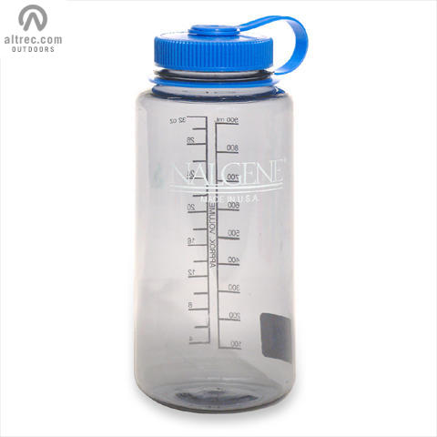
Learning Check
A Nalgene water bottle holds 1000 cm³ of dihydrogen monoxide (DHMO). How many cubic decimeters is that?

Slide 53
Solution
( )
1000 cm³ 1 dm ³
10 cm
= 1 dm³
So, a dm³ is the same as a Liter !
A cm³ is the same as a milliliter.

Slide 54
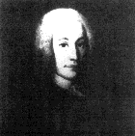
Temperature Scales
Fahrenheit
Celsius
Kelvin
Anders Celsius
1701-1744
Lord Kelvin
(William Thomson)
1824-1907

Slide 55
Temperature Scales
Fahrenheit
Celsius
Kelvin
Boiling point of water
212 ˚F
100 ˚C
373 K
180˚F
100˚C
100 K
Freezing point of water
32 ˚F
0 ˚C
273 K
Notice that 1 kelvin = 1 degree Celsius

Slide 56
Calculations Using Temperature
Generally require temp’s in kelvins
T (K) = t (˚C) + 273.15
Body temp = 37 ˚C + 273 = 310 K
Liquid nitrogen = -196 ˚C + 273 = 77 K

Slide 57
Fahrenheit Formula – Honors Only
180°F = 9°F = 1.8°F 100°C 5°C 1°C
Zero point: 0°C = 32°F
°F = 9/5 °C + 32

Slide 58
Celsius Formula – Honors Only
Rearrange to find T°C
°F = 9/5 °C + 32
°F - 32 = 9/5 °C ( +32 - 32)
°F - 32 = 9/5 °C
9/5 9/5
(°F - 32) * 5/9 = °C

Slide 59
Temperature Conversions – Honors Only
A person with hypothermia has a body temperature of 29.1°C. What is the body temperature in °F?
°F = 9/5 (29.1°C) + 32
= 52.4 + 32
= 84.4°F

Slide 60
Learning Check – Honors Only
The normal temperature of a chickadee is 105.8°F. What is that temperature in °C?
1) 73.8 °C
2) 58.8 °C
3) 41.0 °C

Slide 61
Learning Check – Honors Only
Pizza is baked at 455°F. What is that in °C?
1) 437 °C
2) 235°C
3) 221°C

Slide 62

Can you hit the bull's-eye?
Three targets with three arrows each to shoot.
How do they compare?
Both accurate and precise
Precise but not accurate
Neither accurate nor precise
Can you define accuracy and precision?

Slide 63
Significant Figures
The numbers reported in a measurement are limited by the measuring tool
Significant figures in a measurement include the known digits plus one estimated digit

Slide 64
Counting Significant Figures
RULE 1. All non-zero digits in a measured number are significant. Only a zero could indicate that rounding occurred.
        Number of Significant Figures
38.15 cm 4
5.6 ft 2
65.6 lb ___
122.55 m ___

Slide 65
Leading Zeros
RULE 2. Leading zeros in decimal numbers are NOT significant.
Number of Significant Figures
0.008 mm 1
0.0156 oz 3
0.0042 lb ____
0.000262 mL ____

Slide 66
Sandwiched Zeros
RULE 3. Zeros between nonzero numbers are significant. (They can not be rounded unless they are on an end of a number.)
Number of Significant Figures
50.8 mm 3
2001 min 4
0.702 lb ____
0.00405 m ____

Slide 67
Trailing Zeros
RULE 4. Trailing zeros in numbers without decimals are NOT significant. They are only serving as place holders.
Number of Significant Figures
25,000 in. 2
200. yr 3
48,600 gal ____
25,005,000 g ____

Slide 68
Learning Check
A. Which answers contain 3 significant figures?
  1) 0.4760 2) 0.00476 3) 4760
B. All the zeros are significant in
1) 0.00307 2) 25.300 3) 2.050 x 10³
C. 534,675 rounded to 3 significant figures is
  1) 535 2) 535,000 3) 5.35 x 10⁵

Slide 69
Learning Check
In which set(s) do both numbers contain the same number of significant figures?
1) 22.0 and 22.00
  2) 400.0 and 40
  3) 0.000015 and 150,000

Slide 70
Learning Check
State the number of significant figures in each of the following:
A. 0.030 m 1 2 3
B. 4.050 L 2 3 4
C. 0.0008 g 1 2 4
D. 3.00 m 1 2 3
E. 2,080,000 bees 3 5 7

Slide 71
Significant Numbers in Calculations
A calculated answer cannot be more precise than the measuring tool.
A calculated answer must match the least precise measurement.
Significant figures are needed for final answers from
1) adding or subtracting
2) multiplying or dividing

Slide 72
Adding and Subtracting
The answer has the same number of decimal places as the measurement with the fewest decimal places.
25.2 one decimal place
+ 1.34 two decimal places
26.54
answer 26.5 one decimal place

Slide 73
Learning Check
In each calculation, round the answer to the correct number of significant figures.
A. 235.05 + 19.6 + 2.1 =
1) 256.75 2) 256.8 3) 257
B. 58.925 - 18.2 =
1) 40.725 2) 40.73 3) 40.7

Slide 74
Multiplying and Dividing
Round (or add zeros) to the calculated answer until you have the same number of significant figures as the measurement with the fewest significant figures.

Slide 75
Learning Check
A. 2.19 X 4.2 =
1) 9 2) 9.2 3) 9.198
B. 4.311 ÷ 0.07 =
1) 61.58 2) 62 3) 60
C. 2.54 X 0.0028 =
0.0105 X 0.060
1) 11.3 2) 11 3) 0.041

Slide 76
Reading a Meterstick
. l². . . . I . . . . I³ . . . .I . . . . I⁴. . cm
First digit (known) = 2 2.?? cm
Second digit (known) = 0.7 2.7? cm
Third digit (estimated) between 0.05- 0.07
Length reported = 2.75 cm
or 2.74 cm
or 2.76 cm

Slide 77
Known + Estimated Digits
In 2.76 cm…
Known digits 2 and 7 are 100% certain
The third digit 6 is estimated (uncertain)
In the reported length, all three digits (2.76 cm) are significant including the estimated one

Slide 78
Learning Check
. l⁸. . . . I . . . . I⁹. . . .I . . . . I¹⁰. . cm
What is the length of the line?
1) 9.6 cm
2) 9.62 cm
3) 9.63 cm
How does your answer compare with your neighbor’s answer? Why or why not?

Slide 79
Zero as a Measured Number
. l³. . . . I . . . . I⁴ . . . . I . . . . I⁵. . cm
What is the length of the line?
First digit 5.?? cm
Second digit 5.0? cm
Last (estimated) digit is 5.00 cm

Slide 80
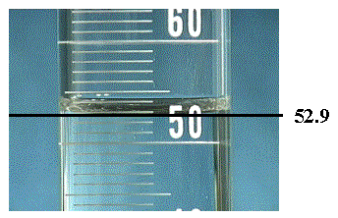
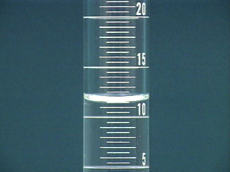
Always estimate ONE place past the smallest mark!

Slide 81

What is Density???

Slide 82
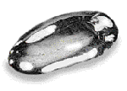
DENSITY - an important and useful physical property
Mercury
Platinum
Aluminum
13.6 g/cm³
21.5 g/cm³
2.7 g/cm³

Slide 83
Problem A piece of copper has a mass of 57.54 g. It is 9.36 cm long, 7.23 cm wide, and 0.95 mm thick. Calculate density (g/cm³).

Slide 84
Strategy
1. Get dimensions in common units.
2. Calculate volume in cubic centimeters.
3. Calculate the density.

Slide 85
SOLUTION
1. Get dimensions in common units.
2. Calculate volume in cubic centimeters.
3. Calculate the density.
(9.36 cm)(7.23 cm)(0.095 cm) = 6.4 cm³
Note only 2 significant figures in the answer!

Slide 86
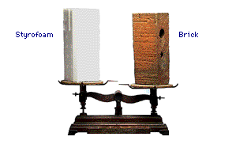
DENSITY
Density is an INTENSIVE property of matter.
  does NOT depend on quantity of matter.
  temperature
Contrast with EXTENSIVE
  depends on quantity of matter.
  mass and volume.
Styrofoam
Brick

Slide 87
PROBLEM: Mercury (Hg) has a density of 13.6 g/cm³. What is the mass of 95 mL of Hg in grams? In pounds?

Slide 88
PROBLEM: Mercury (Hg) has a density of 13.6 g/cm³. What is the mass of 95 mL of Hg?
First, note that 1 cm³ = 1 mL
Strategy
1. Use density to calc. mass (g) from volume.
2. Convert mass (g) to mass (lb)
Need to know conversion factor
= 454 g / 1 lb

Slide 89
PROBLEM: Mercury (Hg) has a density of 13.6 g/cm³. What is the mass of 95 mL of Hg?
1. Convert volume to mass
2. Convert mass (g) to mass (lb)

Slide 90
Learning Check
Osmium is a very dense metal. What is its
density in g/cm³ if 50.00 g of the metal occupies
a volume of 2.22cm³?
1) 2.25 g/cm³
2) 22.5 g/cm³
3) 111 g/cm³

Slide 91
Solution
2) Placing the mass and volume of the osmium metal into the density setup, we obtain
D = mass = 50.00 g =
volume 2.22 cm³
= 22.522522 g/cm³ = 22.5 g/cm³

Slide 92
Volume Displacement
A solid displaces a matching volume of water when the solid is placed in water.
33 mL
25 mL

Slide 93
Learning Check
What is the density (g/cm³) of 48 g of a metal if the metal raises the level of water in a graduated cylinder from 25 mL to 33 mL?
1) 0.2 g/ cm³ 2) 6 g/m³ 3) 252 g/cm³
33 mL
25 mL

Slide 94
Learning Check
Which diagram represents the liquid layers in the cylinder?
(K) Karo syrup (1.4 g/mL), (V) vegetable oil (0.91 g/mL,) (W) water (1.0 g/mL)
1) 2) 3)
V
W
K
K
V
W
V
W
K

Slide 95
Learning Check
The density of octane, a component of gasoline, is 0.702 g/mL. What is the mass, in kg, of 875 mL of octane?
1) 0.614 kg
2) 614 kg
3) 1.25 kg

Slide 96
Learning Check
If blood has a density of 1.05 g/mL, how many liters of blood are donated if 575 g of blood are given?
1) 0.548 L
2) 1.25 L
3) 1.83 L

Slide 97
Learning Check
A group of students collected 125 empty aluminum cans to take to the recycling center. If 21 cans make 1.0 pound of aluminum, how many liters of aluminum (D=2.70 g/cm³) are obtained from the cans?
1) 1.0 L 2) 2.0 L 3) 4.0 L

Slide 98
Scientific Method
State the problem clearly.
Gather information.
Form a _______________.
Test the hypothesis.
Evaluate the data to form a conclusion.
  If the conclusion is valid, then it becomes a theory. If the theory is found to be true over along period of time (usually 20+ years) with no counter examples, it may be considered a law.
6. Share the results.

